Slide 1

SharePoint to Fabric
Service Principal
Security & Permissions

Slide 2

1. Changes for AAD Administrator

Slide 3
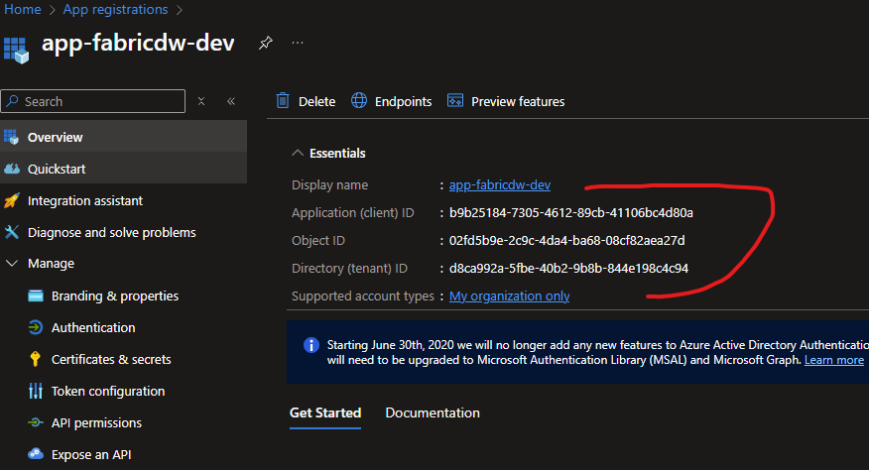
Create App Registration
Create New App registration (or use old one)
Pass on name and details in picture
  Client ID [aka AppID]
  Object ID
  Tenant ID

Slide 4
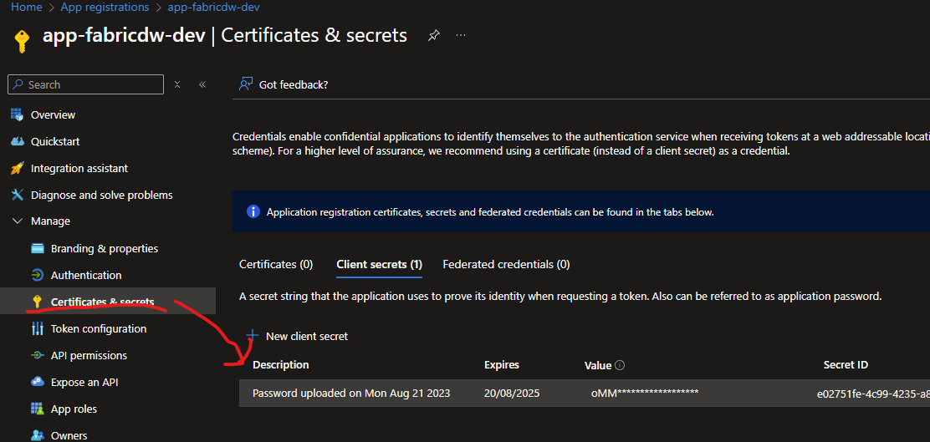
Create App Registration
Create Secret and Pass on
  Secret Valie
  Secret ID
Make sure valid for 24 months

Slide 5
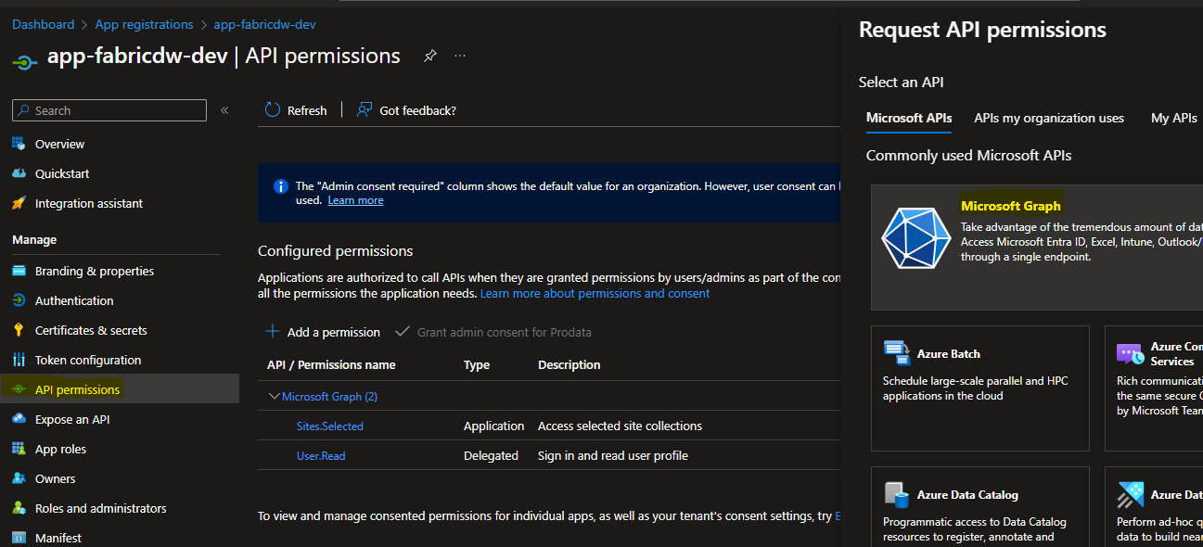
Add Permission to add Permissions

Slide 6
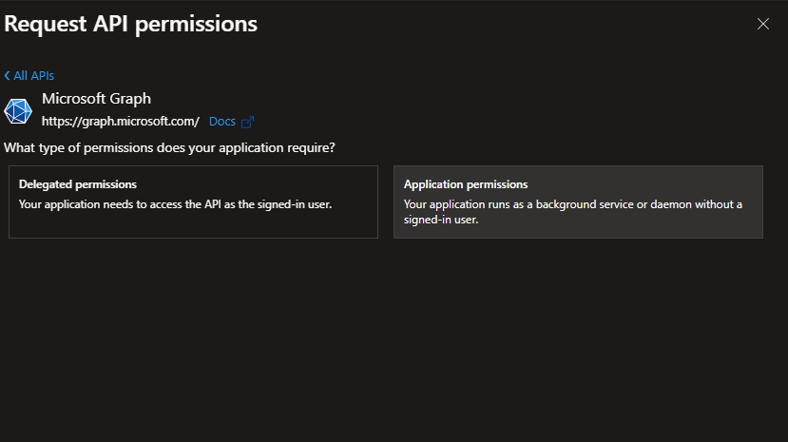
Choose application permission

Slide 7
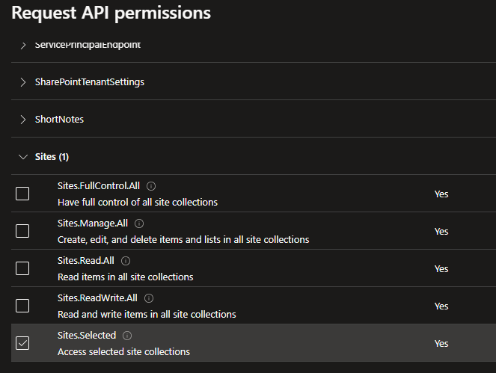
Add Sites.Selected Permission

Slide 8
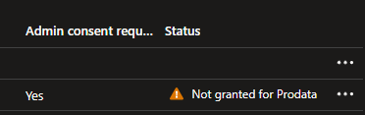
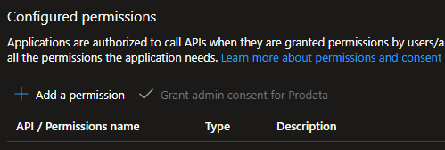
An admin is required to grant admin consent for the permission change.

Slide 9

SharePoint Administrator

Slide 10
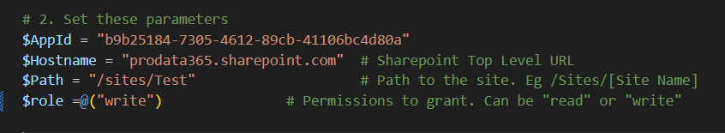
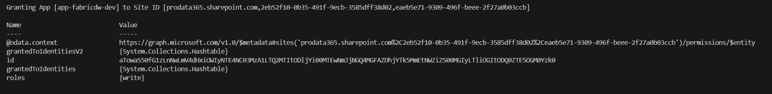
1) Grant App Entra Permissions via Powershell
Copy this PowerShell script into VS Code or PowerShell IDE
https://github.com/ProdataSQL/sharepoint-sites-selected-setup/blob/main/02_SharePoint-Permissions.ps1 Pass Below Parameters and run the script
  $AppId
  $Hostname
  $Path
  $roles
Run Script and check succeeds

Slide 11
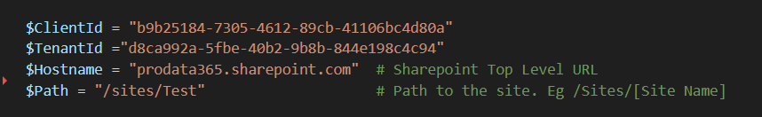
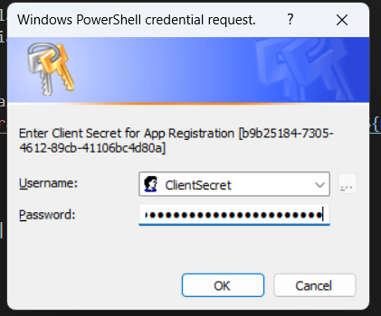
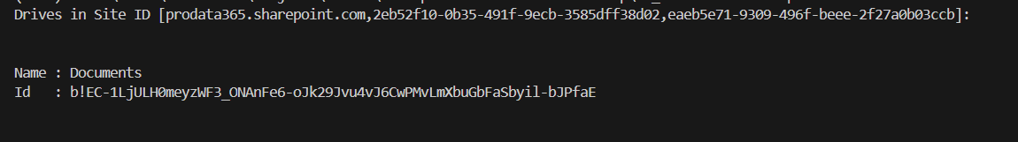
2) Test app Acces to ShaerPoint
Copy this PowerShell script into VS Code or PowerShell IDE
https://github.com/ProdataSQL/sharepoint-sites-selected-setup/blob/main/03_SharePoint-Test.ps1
Pass Below Parameters and run the script
Run Script and enter the Secret when prompted
Script will enumerate Libraries on the Site

Slide 12
1) Grant App Entra Permissions via Powershell
Copy this PowerShell script into VS Code or PowerShell IDE
https://github.com/ProdataSQL/sharepoint-sites-selected-setup/blob/main/03_SharePoint-Test.ps1
Pass Below Parameters and run the script
  $AppId
  $Hostname
  $Path
  $roles
Run Script and check succeeds

